Slide 1
Genius Hour
Round 2 Expectations

Slide 2
What were you likes/dislikes about Genius Hour?

Slide 3
Genius Hour
Is:
A time for you to explore your passions
A time for you to research and create a project
May only work with 1 other partner
Due May 25
Not:
Free time
A teacher assigned topic
Group of 2+ project
Something you do not need to do research on

Slide 4
Choose from anything under these 5 categories...

Slide 5
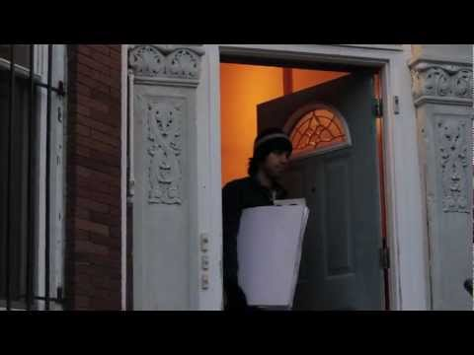
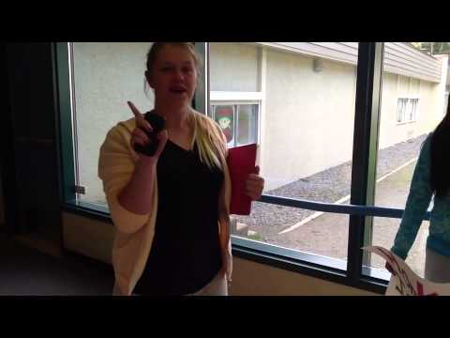
Community Engagement
Inspired by Daniel Pink’s blog
Students created their own campaign
Notes:
Other ideas include fundraisers for local causes, random acts of kindness inside and outside of school, and missions to spread community happiness

Slide 6
2. Passion for a Cause
Have a topic and world problem that you’re passionate about?!
Strive to solve world problems to make the world a better place
Earth Day Examples
Examples: Raising money, having bake sales, cooking dinners for families in need, educate others on how to care for the environment or for animals...etc

Slide 7
IDEAS
Community Engagement
Passion for a Cause
Maker Projects
Filming
Research Idea

Slide 8
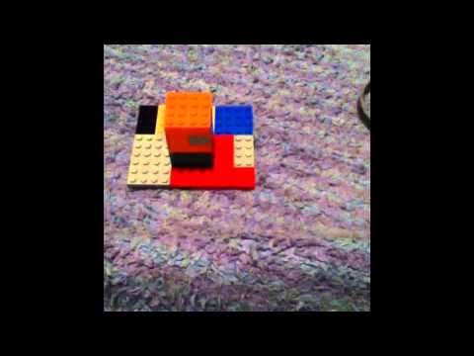
3. Maker Projects
Fine arts, sewing, baking, and building anything and everything
Hydraulic System
Birdhouse
Stop Motion

Slide 9
4. Filmmaking, including Tutorials
Test the new effects of iMovie and other filmmaking apps
Examples
How to Make A Pull Apart Cake
Junior High Survival Guide

Slide 10
5. Research an Area of Interest
Artists
Holidays
Countries of Interest
Historical Moments: WWI or WWII
Create a project based on your research to present!
Ex: poster, slideshow, glogster...etc.

