Slide 1

What is Greek Mythology?
Myth: a story from long ago about gods and goddesses, or supernatural beings
Greek stories that were developed to:
      Tell how the universe began
      Explain something in nature
      Teach us a lesson
      Help us learn a value

Slide 2

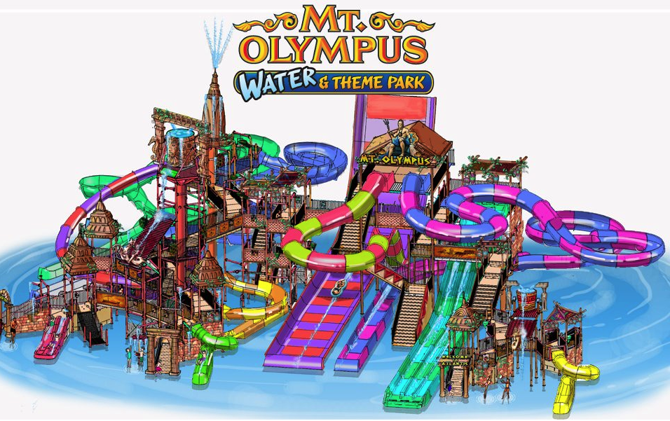
So what?
Why are myths important to me?
    They will help us understand the world around us.
References to Greek mythology are all around us- songs, products, sayings
Allusions=sayings
https://www.youtube.com/watch?v=TH7vXzDoozQ
video of sirens
https://www.youtube.com/watch?v=NU-TSySIWq4

Slide 3
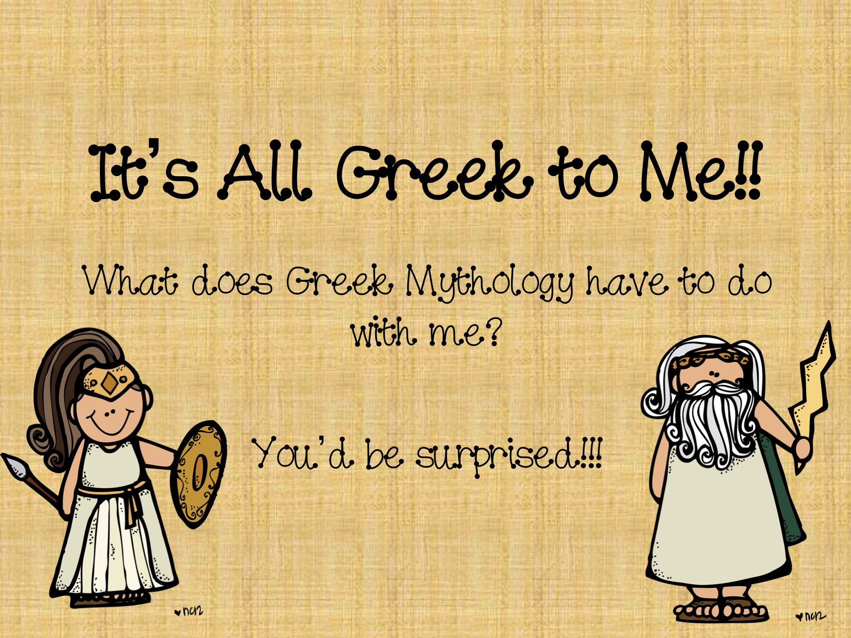

Slide 4
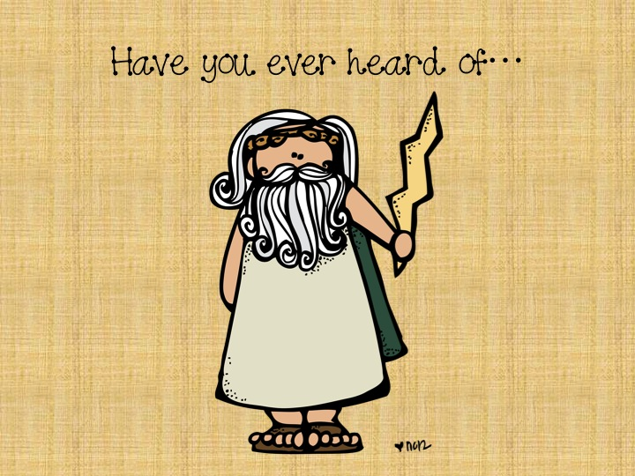

Slide 5
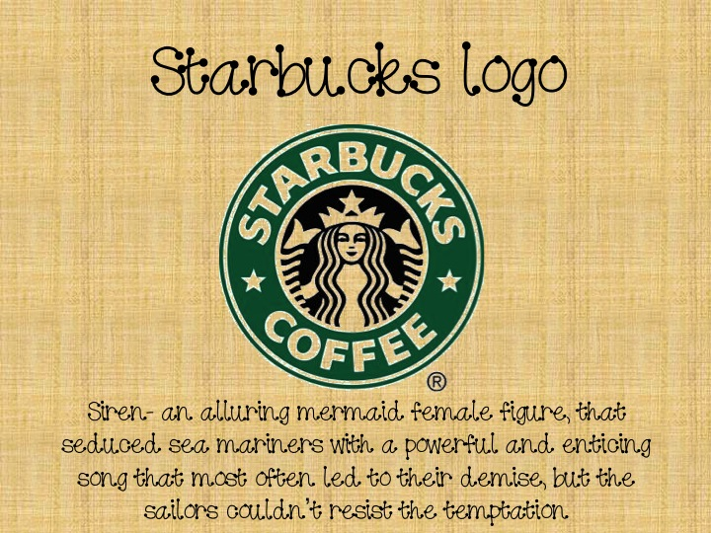

Slide 6
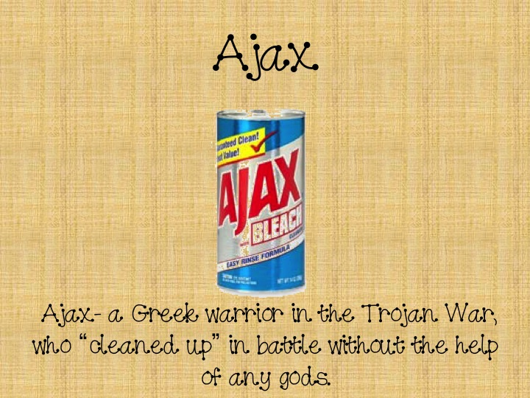

Slide 7


Slide 8


Slide 9
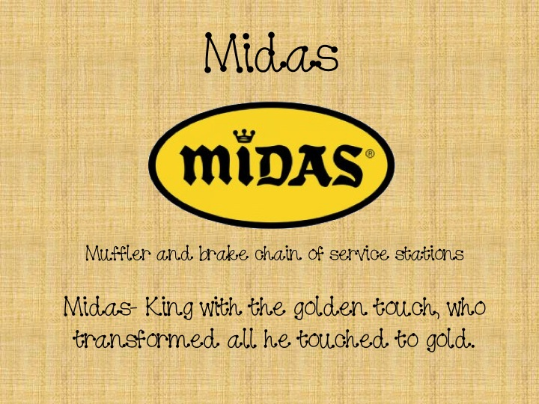

Slide 10
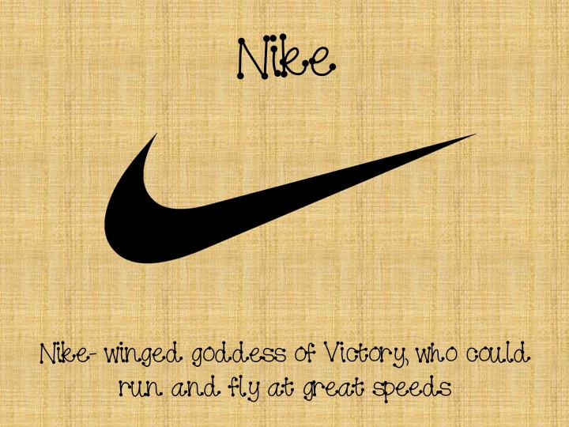

Slide 11
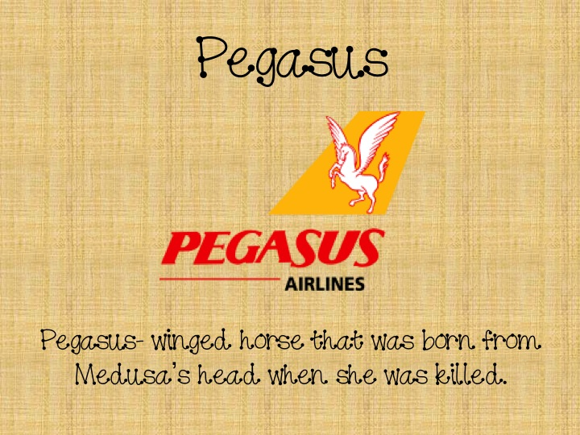

Slide 12
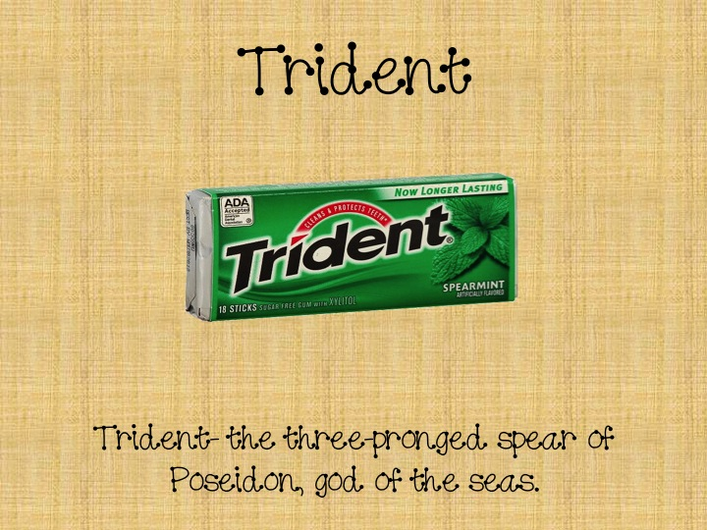

Slide 13
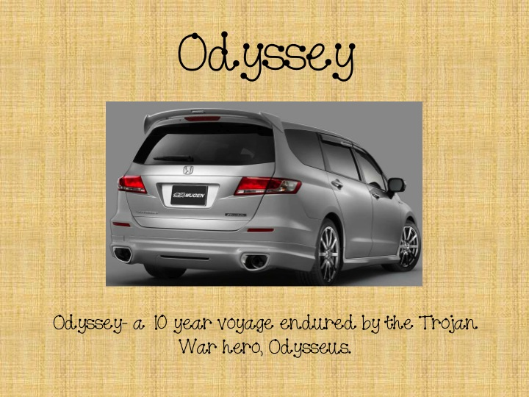

Slide 14


Slide 15
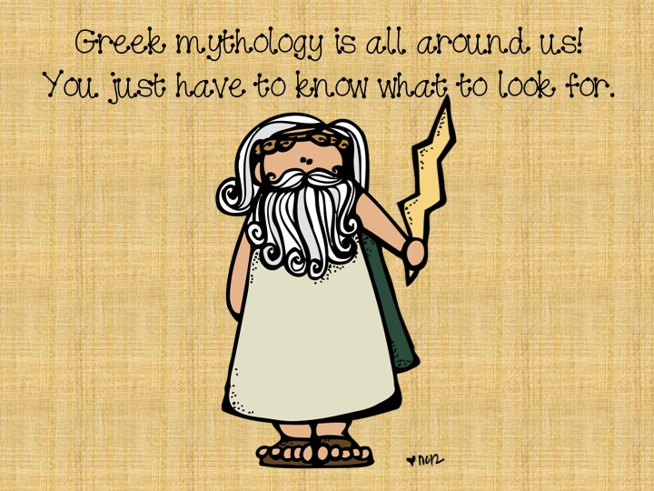

Slide 16
The Golden Touch
View Disney’s King Midas and the Golden Touch. King Midas Safe Share King Midas and the Golden Touch
What does it mean to have “The Golden Touch”?
Did it…
      Tell how the universe began?
      Explain something in nature?
      Teach us a lesson?
      Help us learn a value?

